Slide 1
Analyzing Evidence
Linking Concepts and Supporting your Arguments

Slide 2
Evidence and Claims
What are you trying to prove?
Claim == Point being made about a subject
NOT A FACT!
  Claims are conclusions drawn from facts
  Facts inform claims, but claims are not facts.

Slide 3

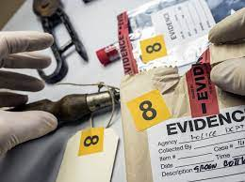
Evidence and Claims
Information used to support a claim
  These are “the facts” used in an argument
  Term is also broadly used to describe primary material being described
    E.g., previous research findings, data in a research study, etc.

Slide 4
Linking Evidence and Claims
Important to support claims with evidence!
Evidence should also naturally lead to claims
Equally important is making it clear to the reader how you’ve arrived at the connection between the two.

Slide 5
Linking Evidence and Claims
Evidence cannot “speak for itself.”
Why? Evidence can be interpreted in different ways!
Author must specify how they are interpreting evidence!

Slide 6
Linking Evidence and Claims
Example: You go to a party
Claim: “There was no alcohol at the party”
How to interpret?
  The party was terrible?
  The party was great?
  Indifference?

Slide 7
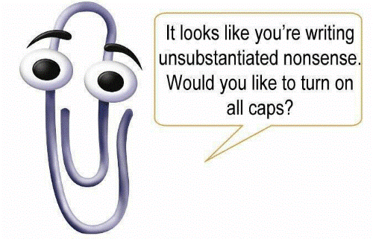
Unsubstantiated Claims
Unsubstantiated == “Without Substance”

Slide 8
Unsubstantiated Claims
The “because I say so” argument
An unsubstantiated claim IS NOT automatically a false claim
The concrete stuff (i.e., evidence) is just missing
Author assumes that the reader will believe the claim by virtue of it being written

Slide 9
Unsubstantiated Claims
“Jumping to conclusions”
Rephrasing generalizations rather than providing evidence
Example:
  You think your new neighbor is Rude. Why? Because they were disrespectful towards you.

Slide 10
Unsubstantiated Claims
Circular argument (Rude and disrespectful are the same in this context)
What specifically was rude or disrespectful about their behavior?
  Do they ignore you?
  Play their music too loud?
  Steal your cable/wifi?

Slide 11
Unsubstantiated Claims
So what’s the solution?
  Provide readers with the evidence leading to the claim
Otherwise, readers must interpret for themselves and that’s never a good idea.
Why?
  They might misinterpret your meaning

Slide 12
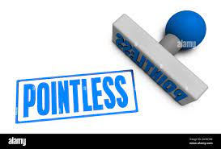
Pointless Evidence
Opposite Problem! Writer presents a mass of evidence but never explains how it relates to the claim.
Solution: State explicitly what you think details mean

Slide 13
The Rules of Argument
The goal of analytical writing is to argue some point
Long-standing tradition of trying to codify the process of connecting evidence and claims
  (i.e., develop “rules” of arguing)

Slide 14
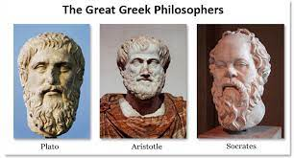
The Rules of Argument
Dates to ancient Greek philosophers
Aristotle (384 – 322 BC)
  Earliest known study of formal logic
  Greatest contribution: The syllogism

Slide 15
Syllogisms
Method for arriving at a logical conclusion
Comprised of three parts:
  Major Premise: a general proposition (assumed to be true)
  Minor Premise: A subordinate proposition (assumed to be true)
  Conclusion: A claim logically drawn from the two premises

Slide 16
Syllogisms: Example
All men are mortal (major premise)
Socrates is a man (minor premise)
Therefore, Socrates is mortal (conclusion)

Slide 17
Short-Comings
A conclusion is only as true as the premises its drawn from
All politicians are corrupt
The mayor of Chicago is a politician
The mayor of Chicago is corrupt

Slide 18
Short-Comings
Syllogisms cannot account for exceptions to rules
All X’s are Y
The Mayor is an X
Therefore, the Mayor is Y.

Slide 19
Short-Comings
Arguments in real life are rarely easy to evaluate
Real life arguments are often Enthymeme
  Incomplete syllogism
  Example: Cats make better bets than dogs because they are more independent
  Unstated: Independent animals are better

Slide 20
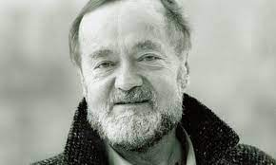
Do Syllogisms Accurately Reflect Argumentative Thought?
Steven Toulmin’s Model (1958)
  Data: “What evidence do you have to go on?”
  Warrant: What general reason did you use to connect data and claim?
  Claim: The conclusion you draw

Slide 21
The Toulmin Model: Example
Data: Maria was born in Puerto Rico
Warrant: Puerto Rico is a U.S. Territory. Individuals born there are American Citizens
Claim: Maria is an American Citizen

Slide 22

Deduction and Induction
Deduction == reasoning from general to particular
Uses evidence to draw out the implications
If “x” happens in a particular situation, will it happen again in another?

Slide 23
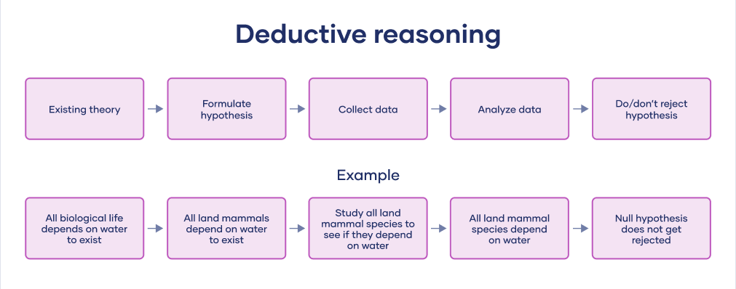

Slide 24
Deduction and Induction
Induction == reasoning from particular to general
“How can this data be explained?”
Using individual cases to inform a general principle

Slide 25
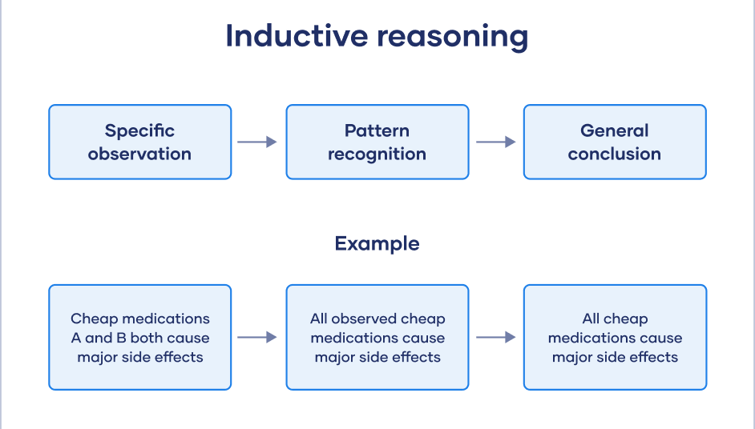

Slide 26
Logical Fallacies
Flawed, deceptive, or false arguments that can be proven wrong with reasoning
Formal fallacies == problems the premise and conclusion of an argument; doesn’t hold up to scrutiny
Informal fallacies == problems with content, form or structure of the argument

Slide 27
1) Ad Hominem
Personal attacks rather than logic.
Occurs when a viewpoint is rejected based on the person making the argument rather than its contents
Example: Don’t trust Dr. Maxwell. People from Mississippi are liars

Slide 28
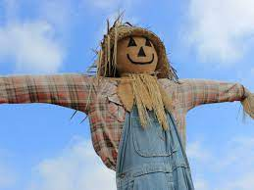
2) Straw Man
Attacks a different subject rather than the topic being discussed
Misdirection designed to make one’s position look stronger than it actually is

Slide 29
Straw Man Example
“Sports funding should be examined to for potential overspending/waste”
“They want to cut the football team!”

Slide 30
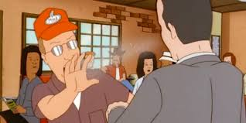
3) Appeal to Ignorance
Something must be true because it has either been proven false or these is no evidence against it.
“No one has proven aliens don’t exist, so they must be real”

Slide 31
4) False Dilemma/Dichotomy
Only presents limited options (usually two extremes”
Examples:
  America! Love it or leave!
  Either you love me or hate me.

Slide 32
5) Slippery Slope
Assuming that a specific action will lead to a chain of future events
Benign → Ridiculous
Provides no evidence
Example:
  If you don’t let me go to this party, I’ll be a loser and everyone will hate me!

Slide 33
6) Hasty Generalization
Basing a claim on few examples rather than substantial proof
Common! Unclear when enough proof is “substantial”

Slide 34
7) Causal Fallacy
Informal fallacy that occurs when an argument incorrectly concludes that a cause is related to an effect
Example:
  Jimmy isn’t at school today, so he must be sick

Slide 35
8) Appeal to Authority
Misuse of an authority’s opinion to support an argument
Example:
  Citing a foot doctor when trying to prove something related to psychiatry

Slide 36
9) Equivocation
Uses a word, phrase, or sentence to deliberately confuse deceive, or mislead
Saying one thing but meaning another
Example:
  “Spending tax dollars on big government” vs. “strategic federal investment in critical programs”

Slide 37
What Counts as Evidence?
Relevance
  How does the evidence related to the claim or problem being addressed?
  Do the facts really apply in this situation?
Framing
  In what ways is the evidence colored by viewpoint or assumptions?
  Do these factors limit its authority?

Slide 38
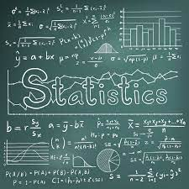
Statistical Evidence
Common in the social science (i.e., psychology!)
Statistics do not speak for themselves!
  Must be interpreted!
  Never assume that stats are a valid representation of what they are supposed to measure
  There will always be error!

Slide 39
Interpreting Statistics
What statistical evidence are you likely to encounter?
  Means and standard deviations (or confidence intervals)
    Reported in-text, figures, or tables
  Statistical Significance
  Effect Sizes

Slide 40
Statistical Significance??
Statistical Significance (p-value)
  What’s it assessing? Probability that a finding would occur by chance.
  p < .05 == statistical significance
But what does that mean?
  Whatever the researchers found is most likely due to their experiment and not chance

Slide 41
Correlations and Cause and Effect
1.) No variable is manipulated
  There is no experimental context
  There is no random assignment to conditions
  No knowledge of the “range of the scale”
    E.g., how high or low can ice cream sales go?
2.) “Direction of Causation” Problem
  Cannot tell whether X caused Y, or whether Y caused X
  Chicken-Egg Question
  E.g., the amount of time spent reading is positively correlated with vocabulary test performance

Slide 42
Correlation ≠ Causation
3.) “Third Variable” Problem
  X and Y may simply share a common cause, a third variable (Z)
  Thus, the correlation would be “spurious”
    Correlations can at times appear random or have no explanation for their occurrence

Slide 43
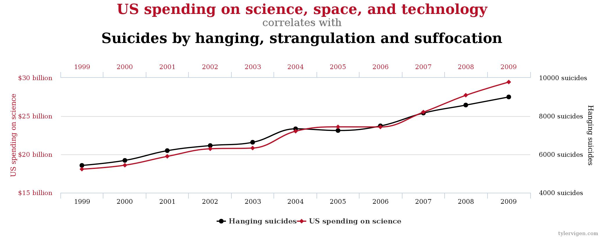
Spurious Correlations
r = .998

Slide 44
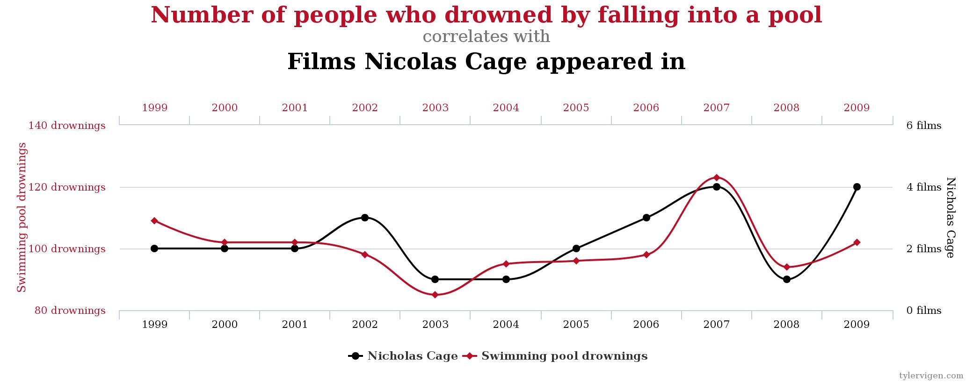
Spurious Correlations
r = .666

Slide 45
Anecdotal Evidence
Anecdote == a story or narrative, an experience
Extreme opposite of statistical evidence
Potential problems:
  Limited to individual cases, cannot generalize to other instances
  Only useful when interested in specific cases (i.e., case studies or narrative designs)

Slide 46
Guidelines and Best Practices
Learn to recognize unsubstantiated claims, rather than assuming all claims are inherently true.
Make details speak. Explain how evidence confirms or supports your claim AND provide your reasons.
Don’t make generalizations based on too little evidence

Slide 47
Questions?

